Slide 1
Preprocessing, spectral analysis and alignment
October 2024
Andrea Corrado

Slide 2
Outline
Recap of objectives so far
Signal preprocessing
Spectrum estimation
Signals alignment
Possible features of Rov Signals
Conclusions

Slide 3
Outline
Recap of objectives so far
Signal preprocessing
Spectrum estimation
Signals alignment
Possible features of Rov Signals
Conclusions

Slide 4
Recap of the objectives so far
So far, data has been explored to find out their inner characteristics.
Proprieties in time domain
Proprieties in frequency domain
To do it, three questions should be answered:
Does data require preprocessing? Which could be a good pipeline?
How can we evaluate the frequency characteristics of these signals?
Does data require to be aligned? If yes, how proceed with alignment?
Target : building a population dataset

Slide 5
Outline
Recap of objectives so far
Signal preprocessing
Spectrum estimation
Signals alignment
Possible features of Rov Signals
Conclusions

Slide 6
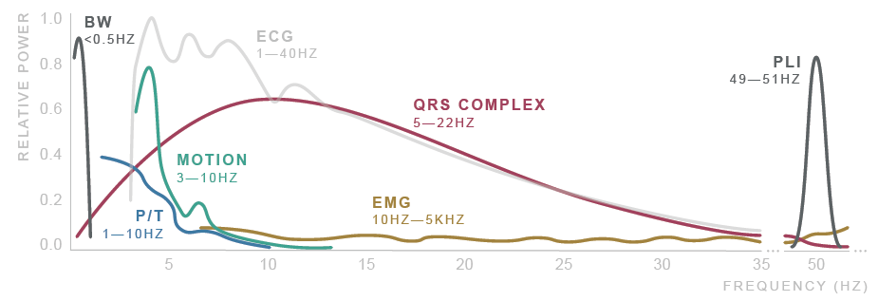
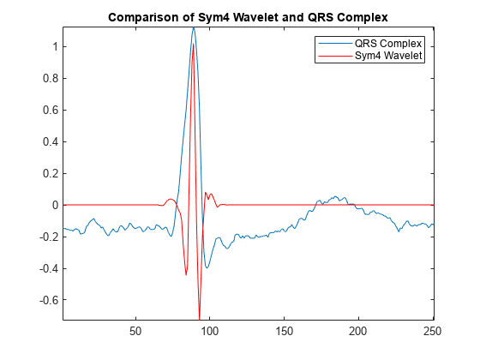
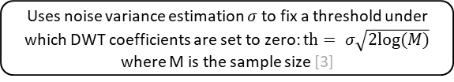
Signal preprocessing
ECG signals noisy and require to be preprocessed and filtered [1]
Noise sources: Physiological, Environmental, Artifacts, Electronic…
After literature research, the proposed filtering method [1,2] consists of:
Donoho thresholding [3] on discrete wavelet transform coefficients (DWT)
Shrink the coefficients related to, presumably, high frequency noise and low frequency noise
Followed by zero-phase band pass filtering
Improves the result eliminating residual noise
Original signal
DWT decomposition
Symlets 4 wavelet is used due to its good performances on ECG signals [2, 3]
Donoho soft thresholding
Uses noise variance estimation $σ$ to fix a threshold under which DWT coefficients are set to zero: $th= σ\sqrt{2log⁡(M)}$ where M is the sample size [3]
DWT reconstruction
Butterworth HP filter (order 6, cutoff at 0.5 Hz)
Butterworth LP filter (order 6, cutoff at 60 Hz)
1. Saraiva, João & Plácido da Silva, Hugo & Fred, Ana. (2022). Denoising and Artifact Removal of the Electrocardiogram, Electrodermal Activity and Accelerometery for Continuous Ambulatory Monitoring of Epileptic Seizures with Wearable Devices.
2. Singh, Brij N., and Arvind K. Tiwari. "Optimal selection of wavelet basis function applied to ECG signal denoising." Digital signal processing 16.3 (2006): 275-287.
3. Donoho, David L. "De-noising by soft-thresholding." IEEE transactions on information theory 41.3 (1995): 613-627.

Slide 7
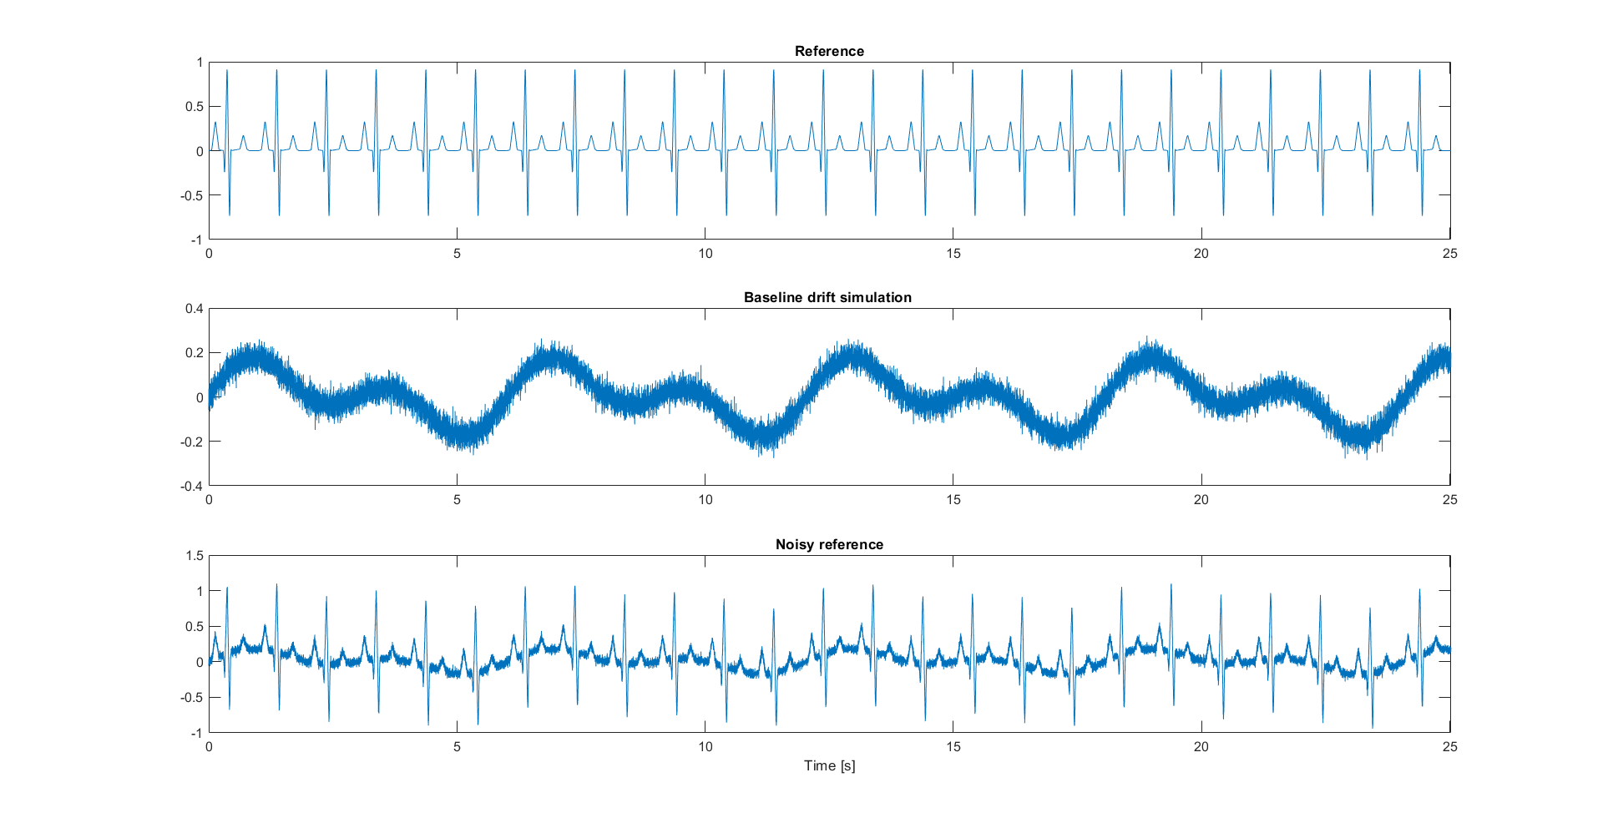
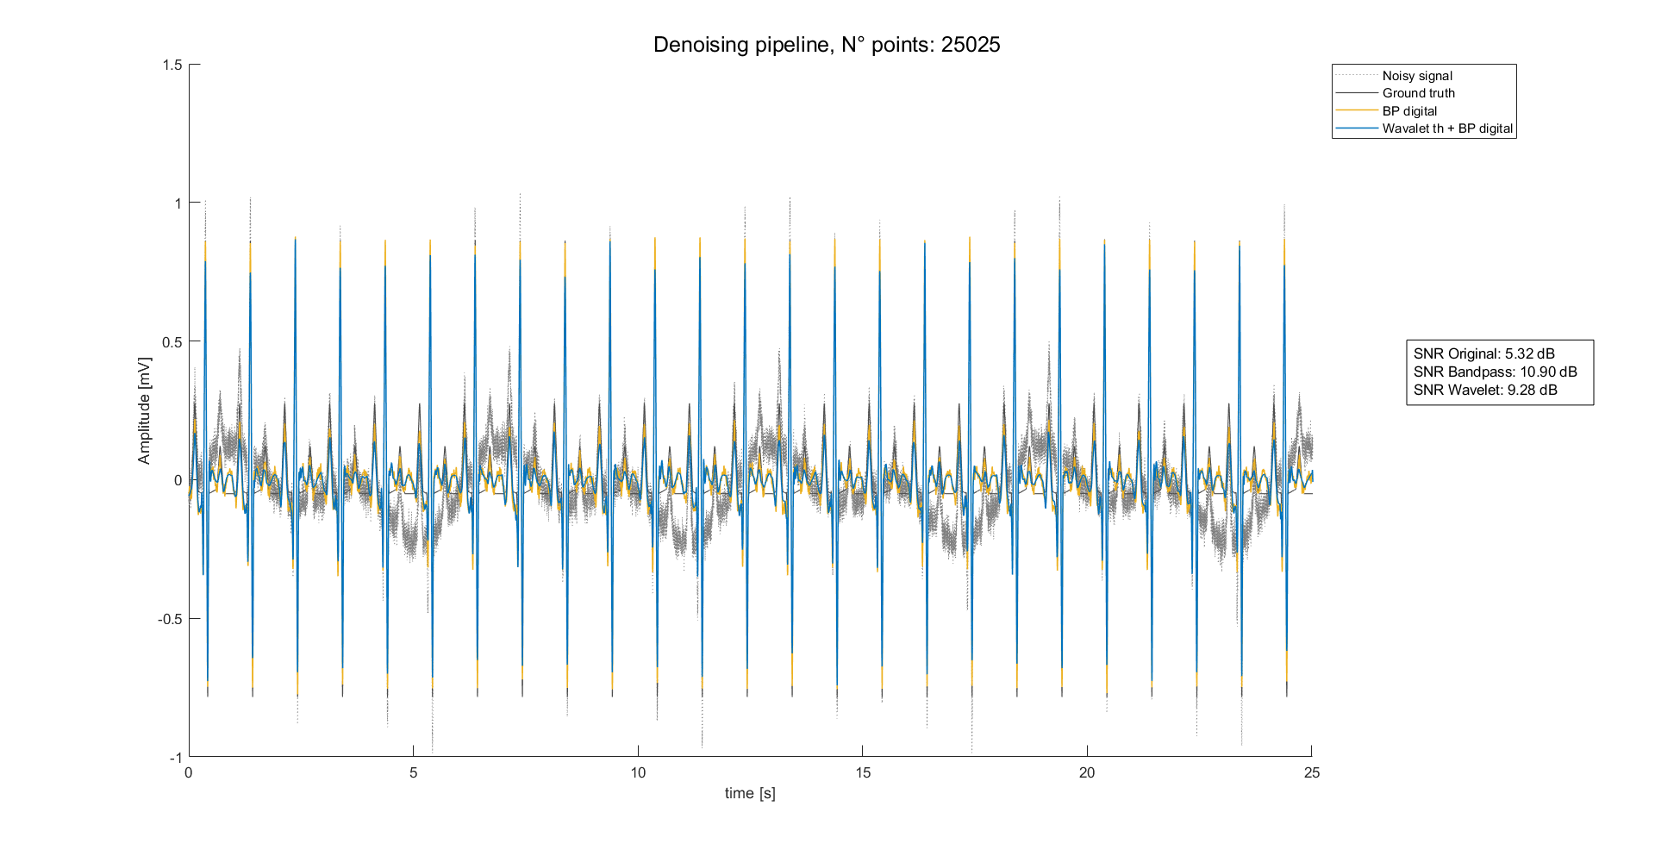
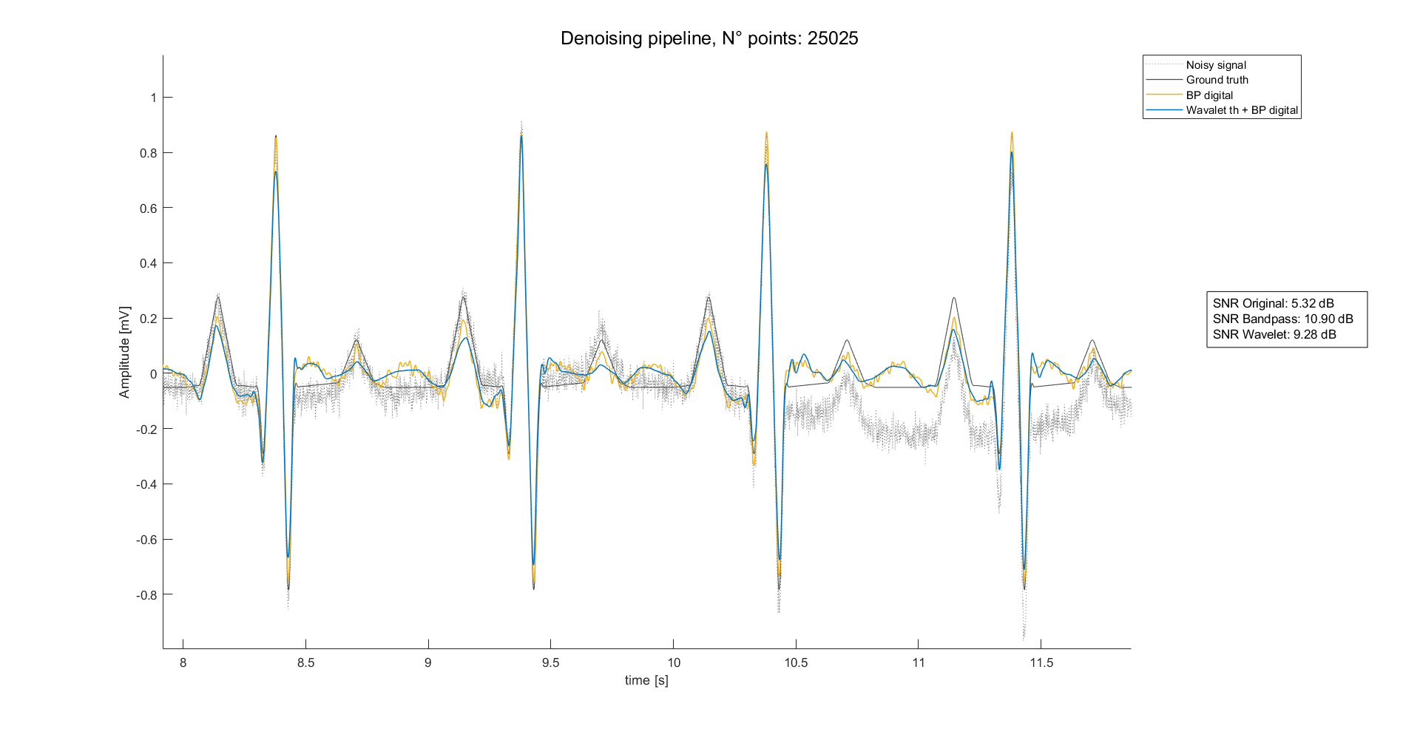
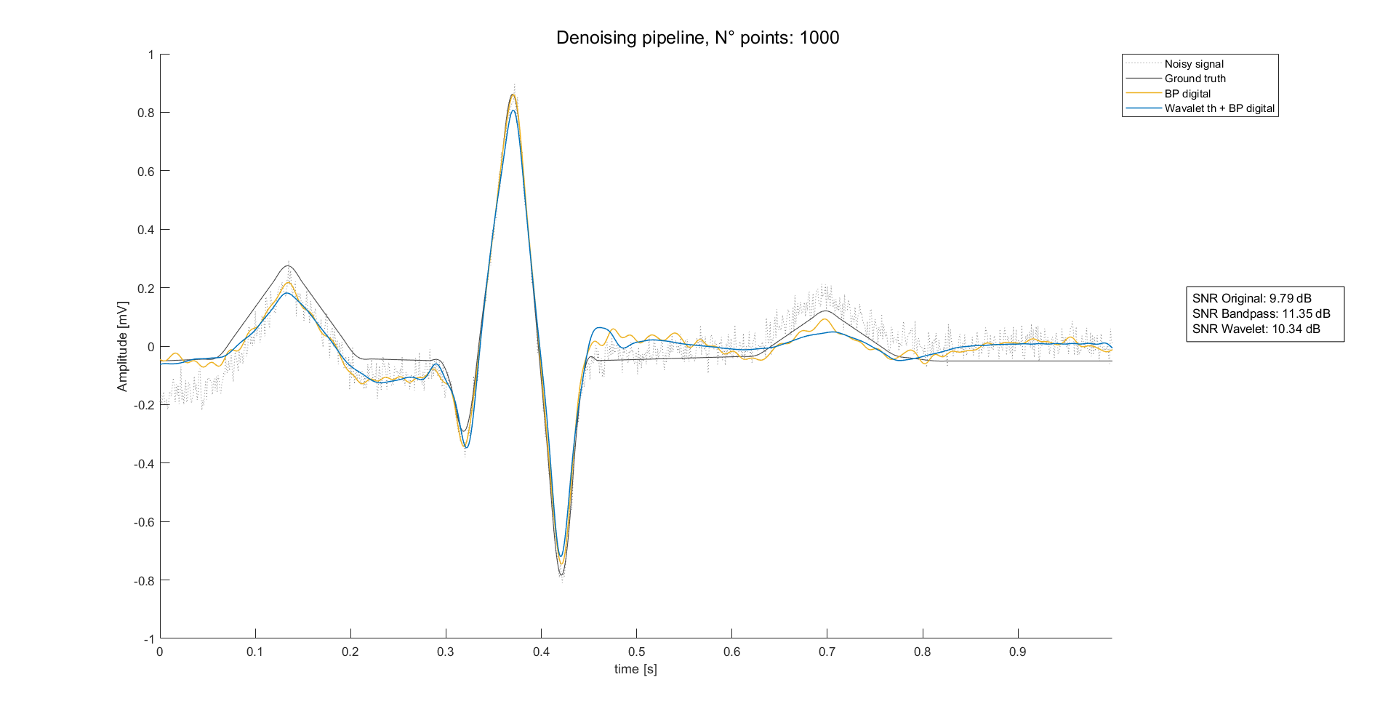
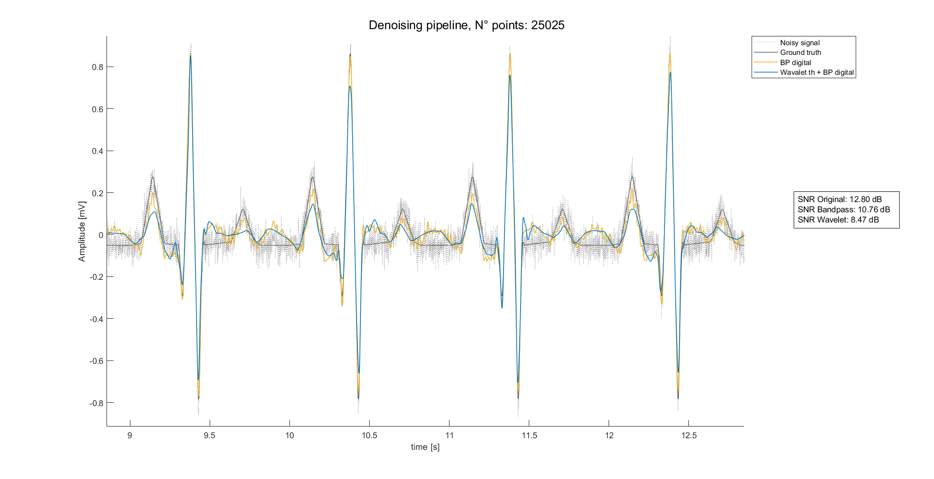
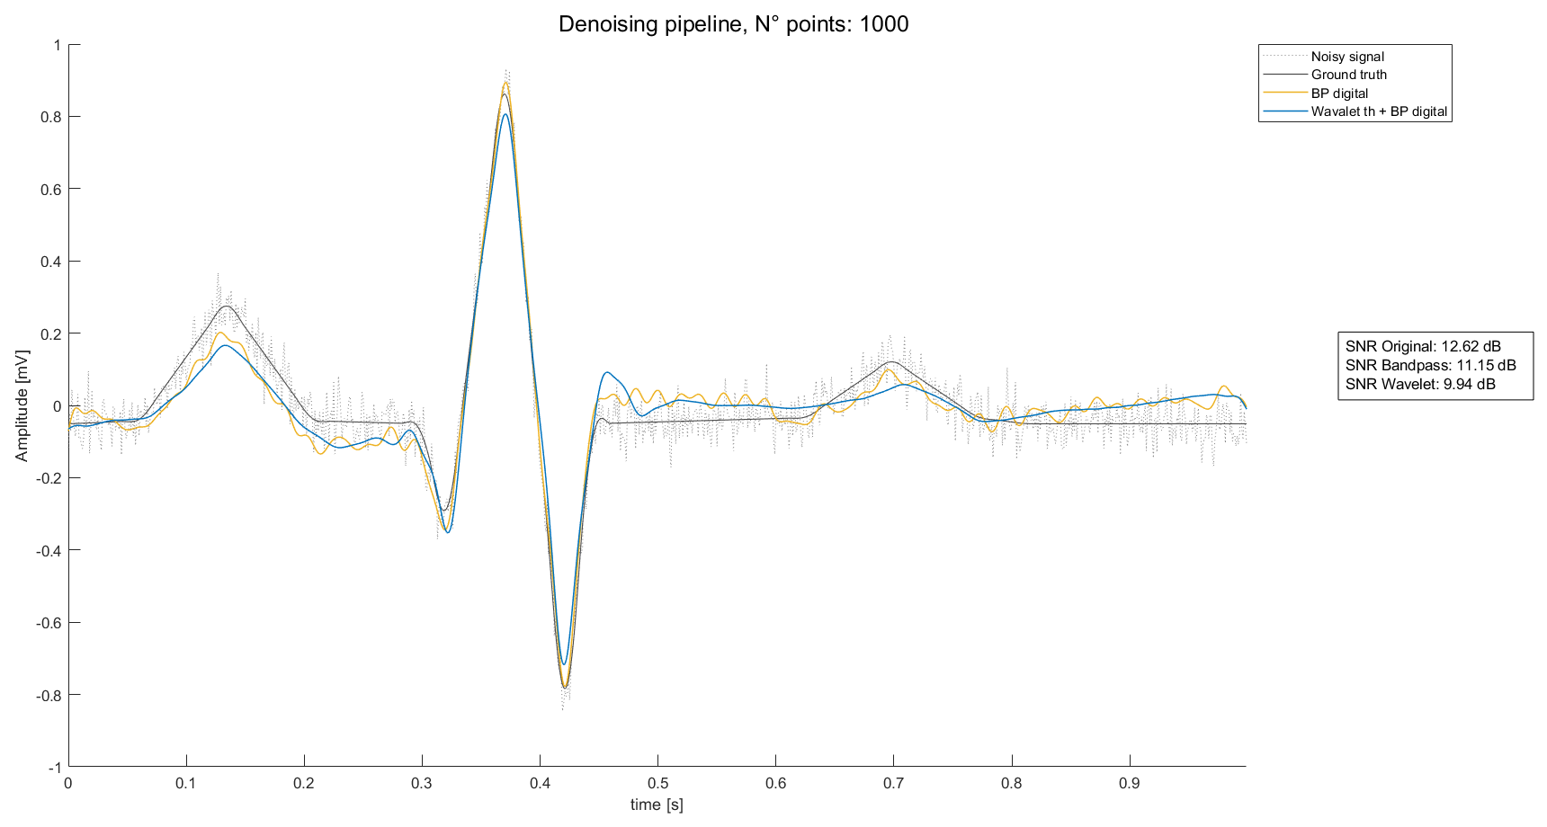
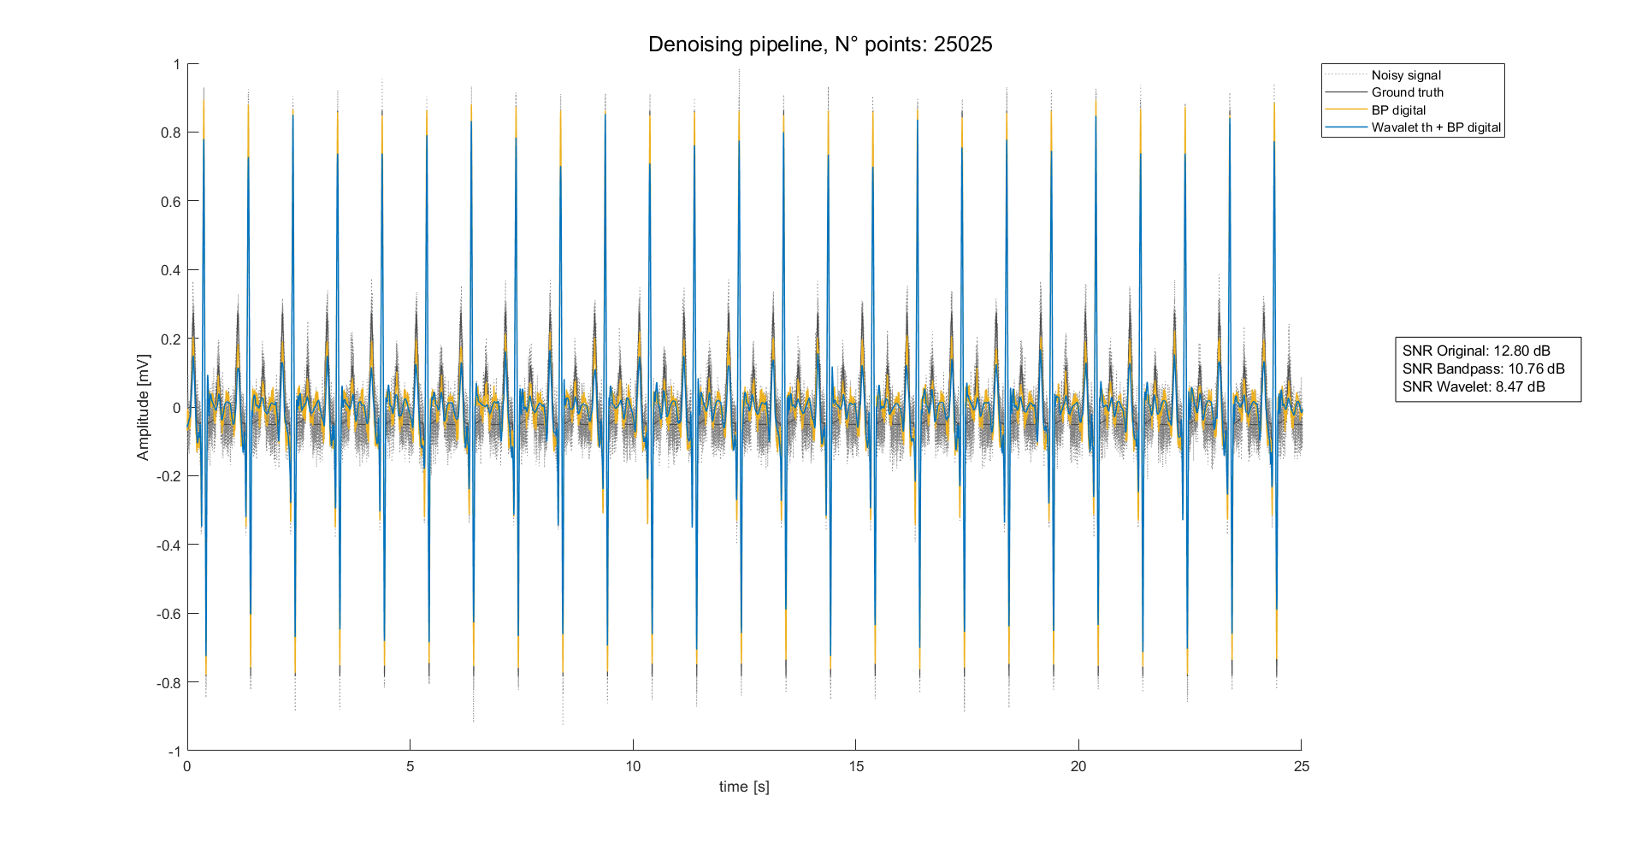
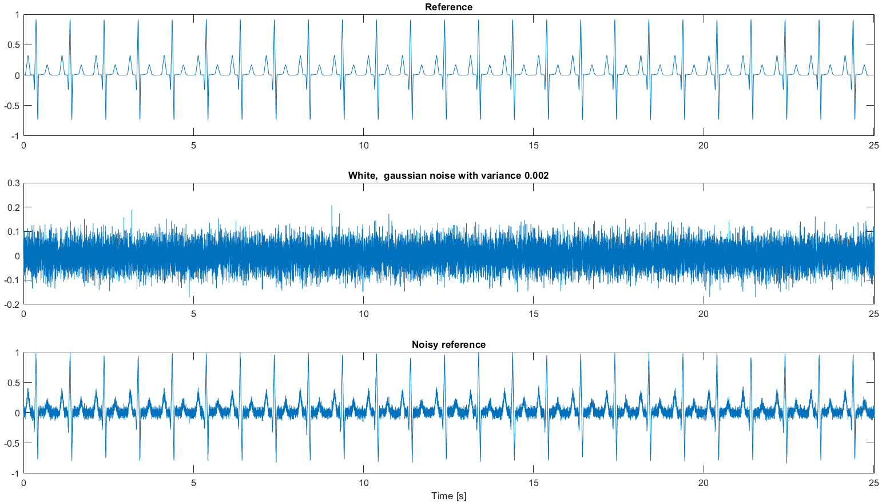
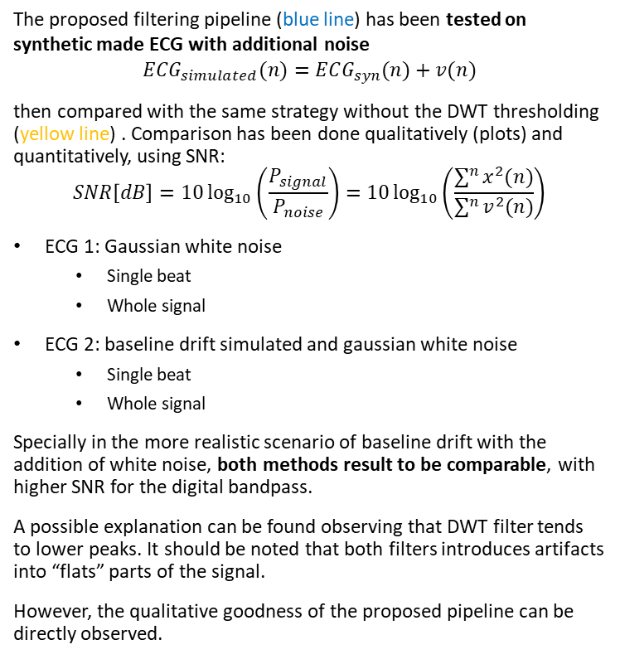
Preprocessing results: Synthetic data
The proposed filtering pipeline (blue line) has been tested on synthetic made ECG with additional noise
$$ECG_{simulated}(n)=ECG_{syn}(n)+v(n)$$
then compared with the same strategy without the DWT thresholding (yellow line) . Comparison has been done qualitatively (plots) and quantitatively, using SNR:
$$SNR\left[dB\right]=10\log_{10}\left(\frac{P_{signal}}{P_{noise}}\right)=10\log_{10}\left(\frac{\sum^{n}{x^{2}(n)}}{\sum^{n}{v^{2}(n)}}\right)$$
ECG 1: Gaussian white noise
Single beat
Whole signal
ECG 2: baseline drift simulated and gaussian white noise
Single beat
Whole signal
Specially in the more realistic scenario of baseline drift with the addition of white noise, both methods result to be comparable, with higher SNR for the digital bandpass.
A possible explanation can be found observing that DWT filter tends to lower peaks. It should be noted that both filters introduces artifacts into “flats” parts of the signal.
However, the qualitative goodness of the proposed pipeline can be directly observed.

Slide 8
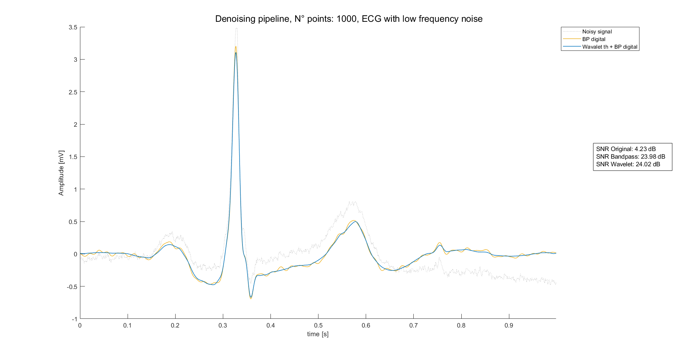
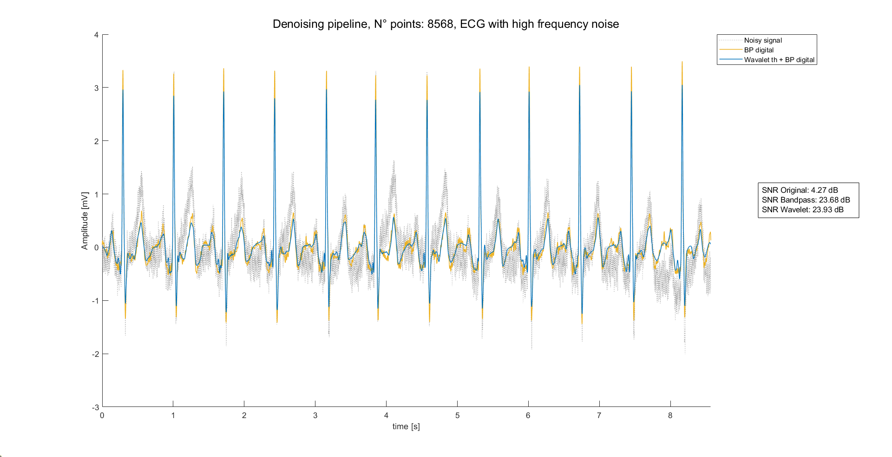
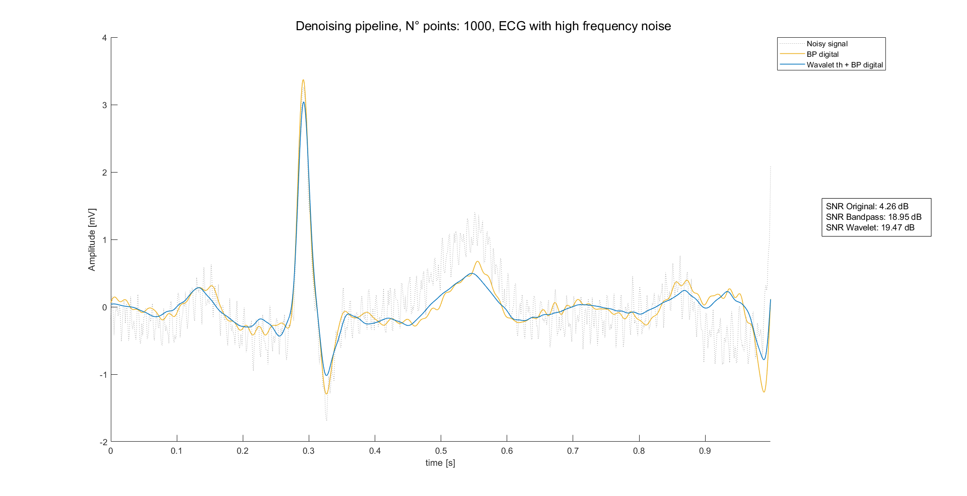
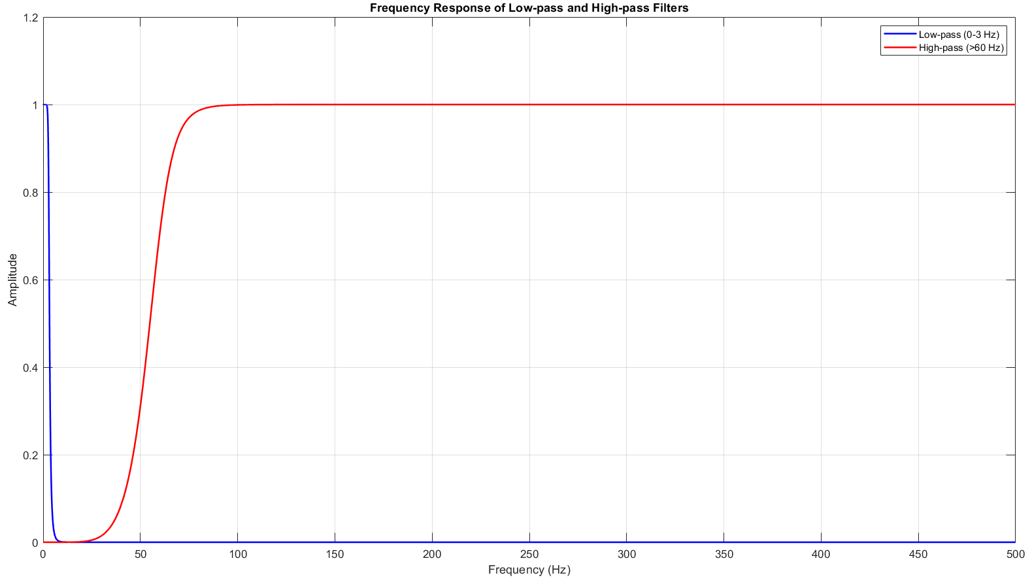
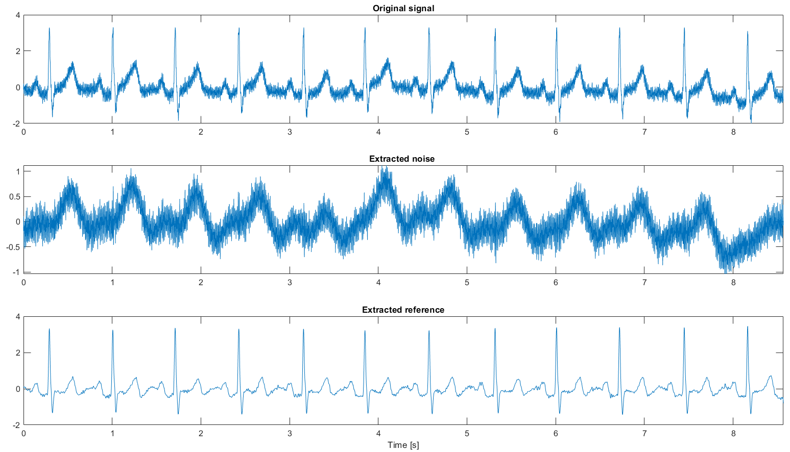
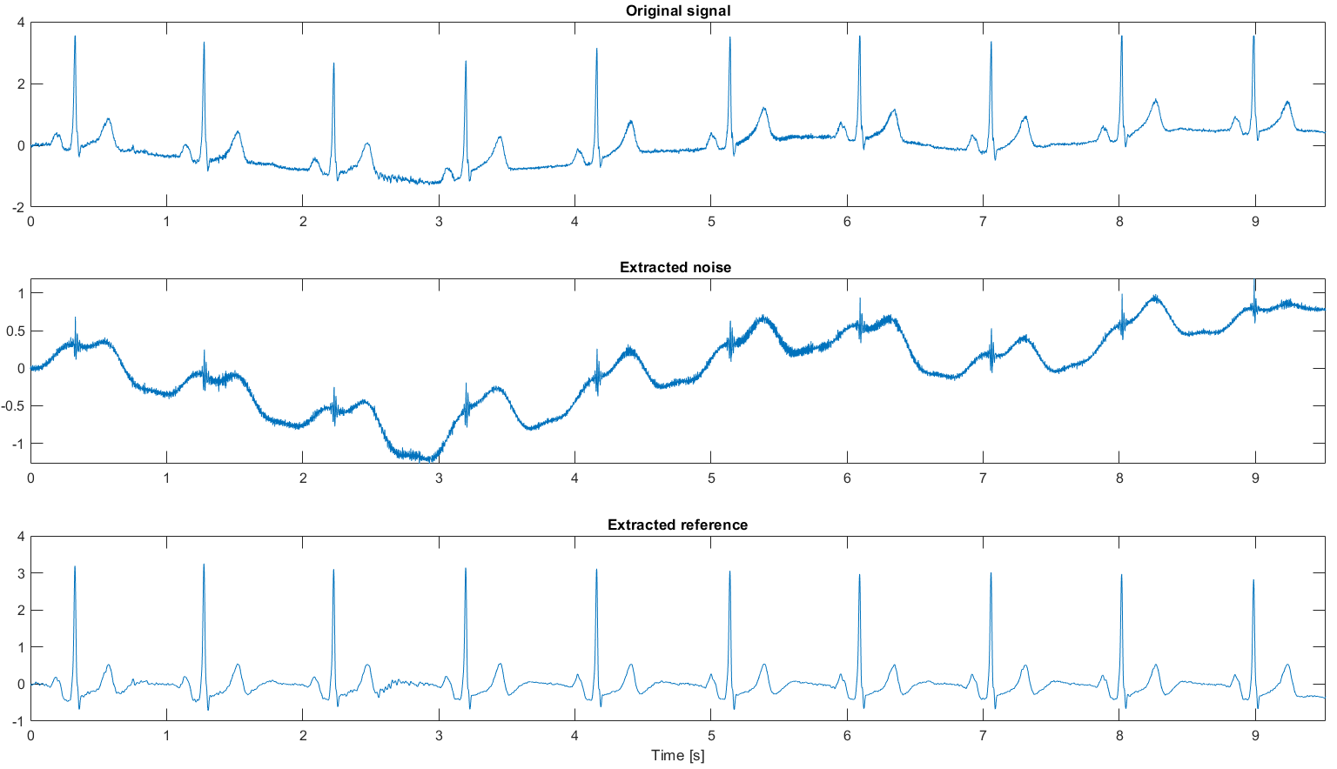
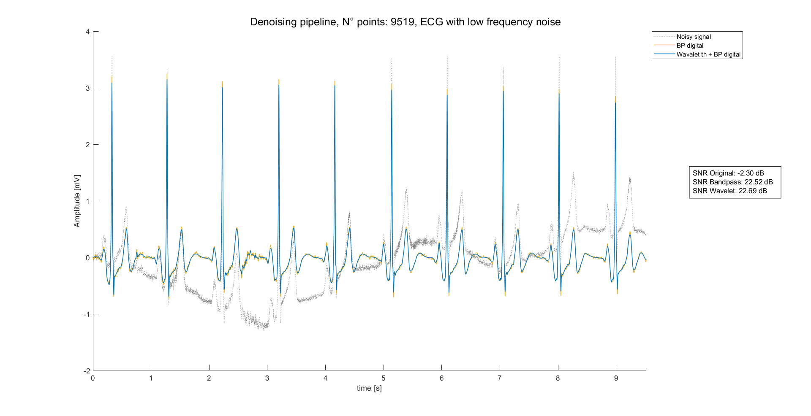
Preprocessing results: External data
The proposed filtering pipeline (blue line) has been tested on well-know external data (didactical) and compared with the same strategy without the DWT thresholding (yellow line). Again, results are both qualitative and quantitative (SNR).
In this case, noise has been obtained indirectly summing the output of the signal through:
High pass filter: to obtain high frequency noise
Low pass filter: to obtain low frequency noise
Again, there are 2 scenarios:
ECG 1: HF noise
Filter performance on single beat
Filter performance on whole signal
ECG 2: LF noise
Filter performance on single beat
Filter performance on whole signal
In conclusion, DWT thresholding combined with BP zero-phase filtering leads to good results, comparable with digital filter performance.
Moreover, this strategy has other known advantages:
Higher performance even on other sources of noise [1]
Good performances on short signals [1,2]
1. Saraiva, João & Plácido da Silva, Hugo & Fred, Ana. (2022). Denoising and Artifact Removal of the Electrocardiogram, Electrodermal Activity and Accelerometery for Continuous Ambulatory Monitoring of Epileptic Seizures with Wearable Devices.
2. Singh, Brij N., and Arvind K. Tiwari. "Optimal selection of wavelet basis function applied to ECG signal denoising." Digital signal processing 16.3 (2006): 275-287.

Slide 9
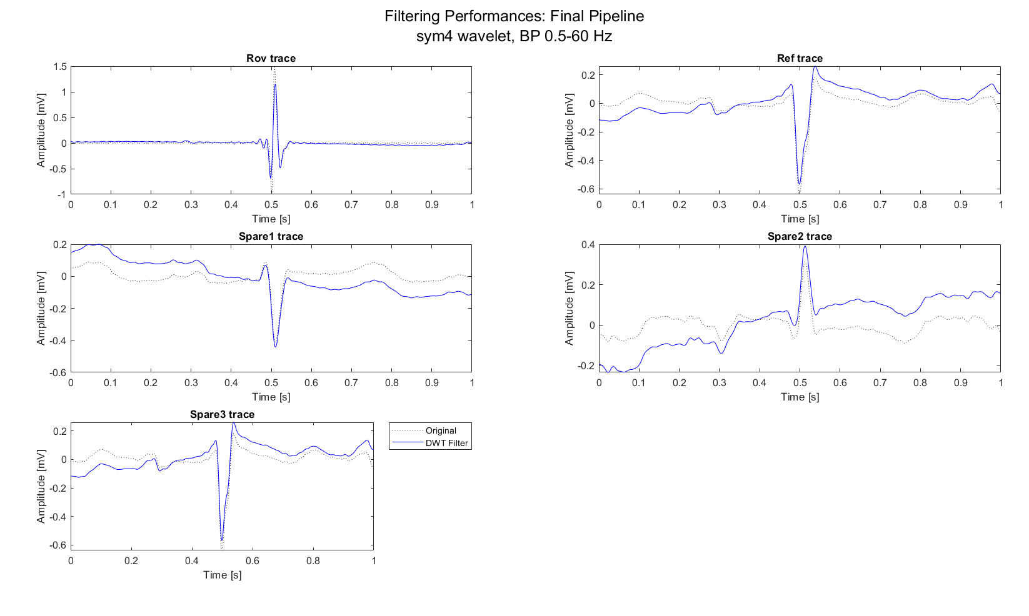
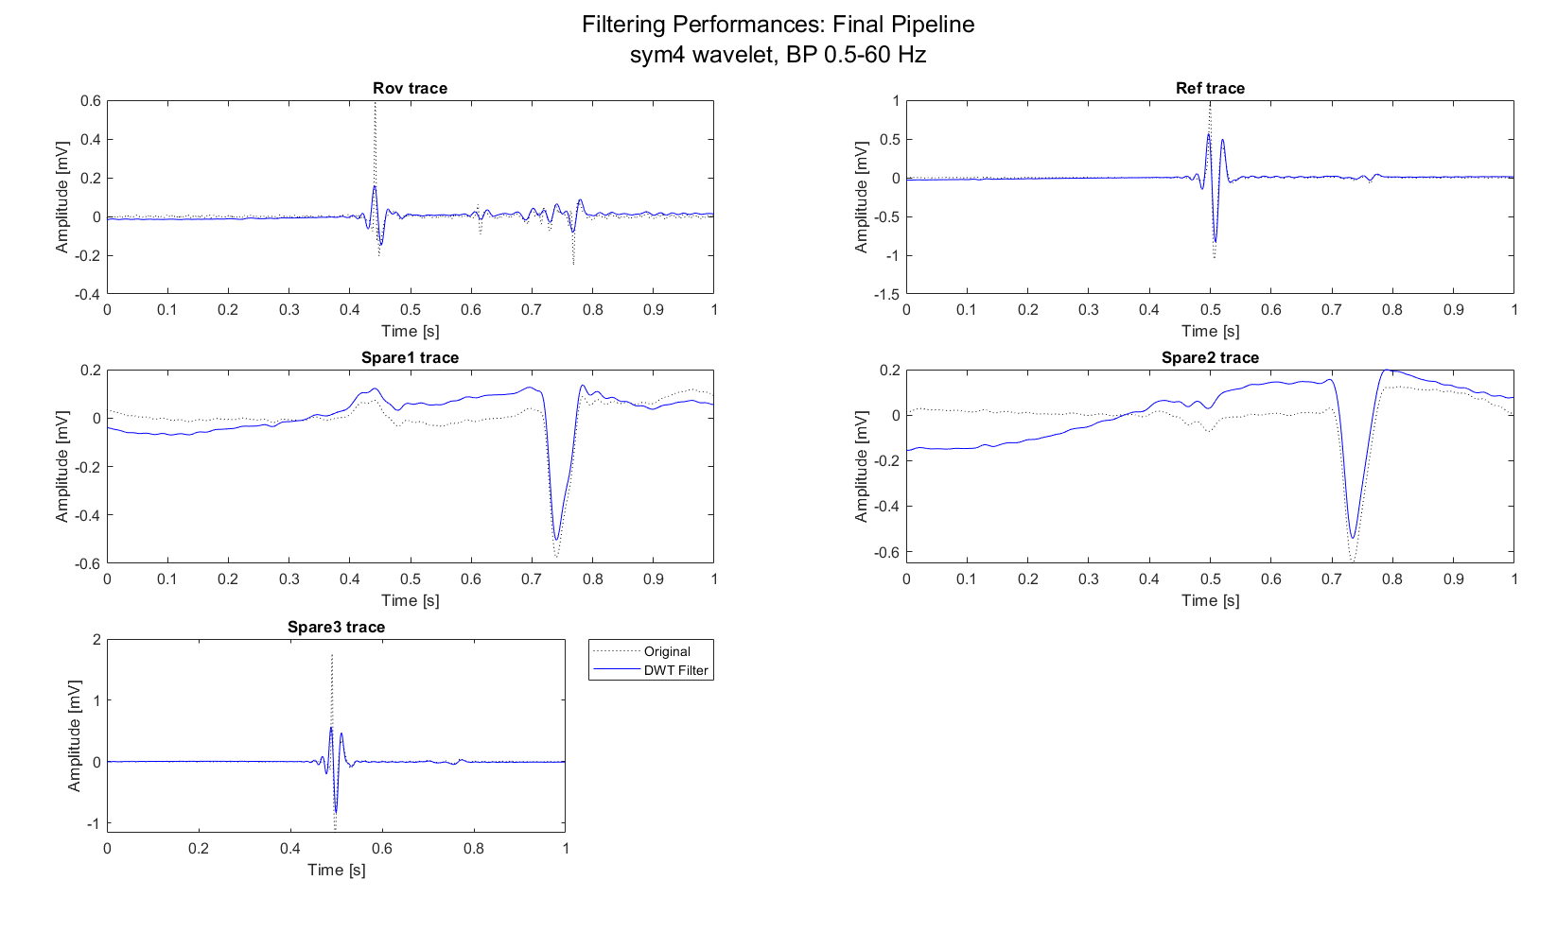
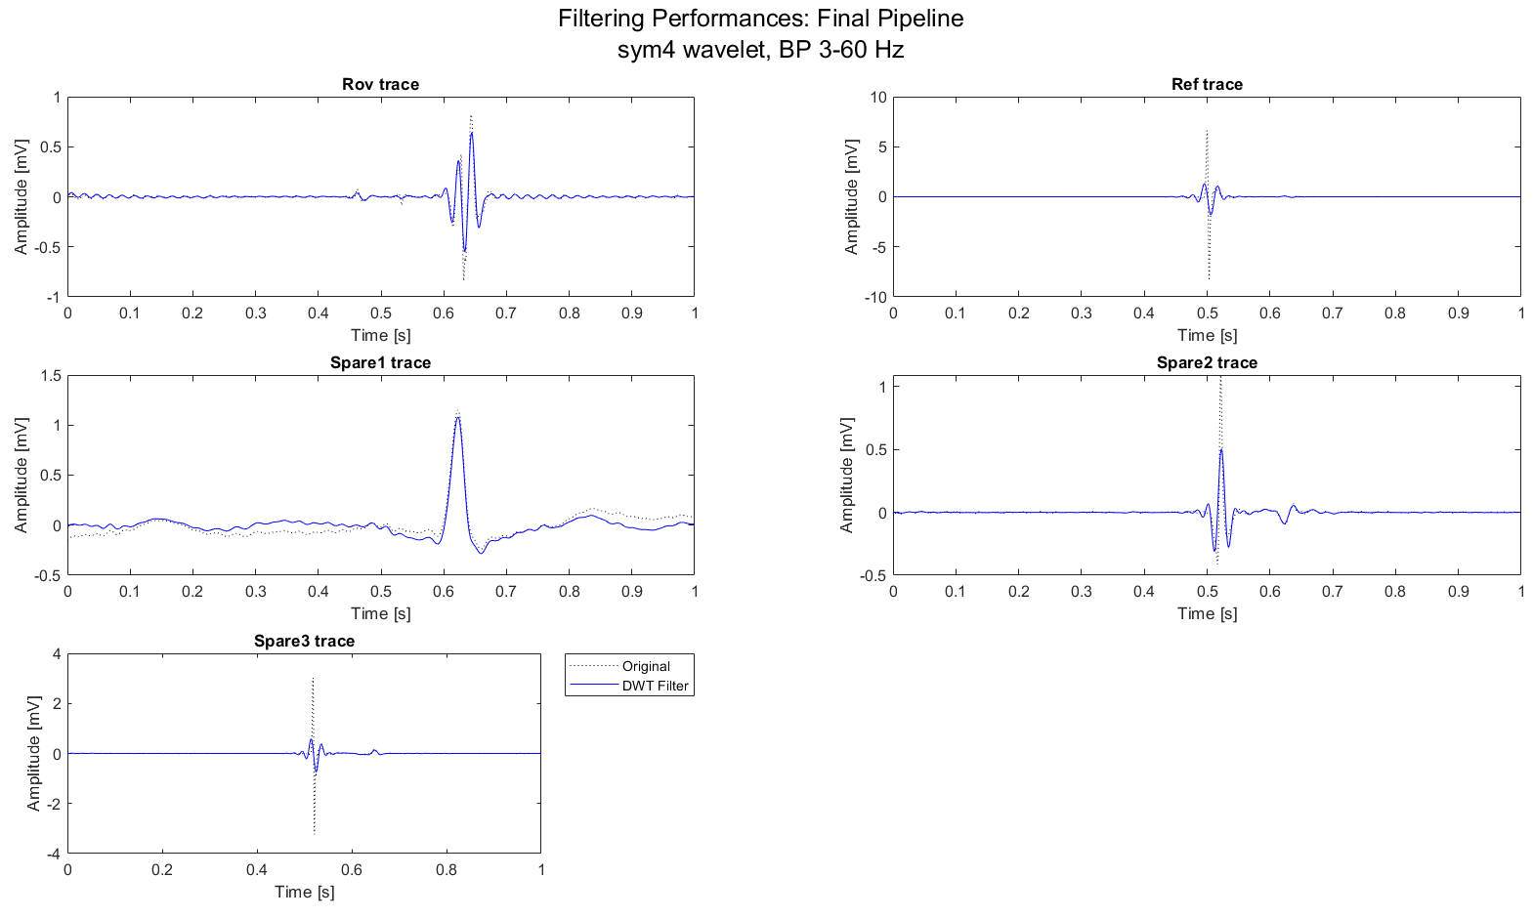
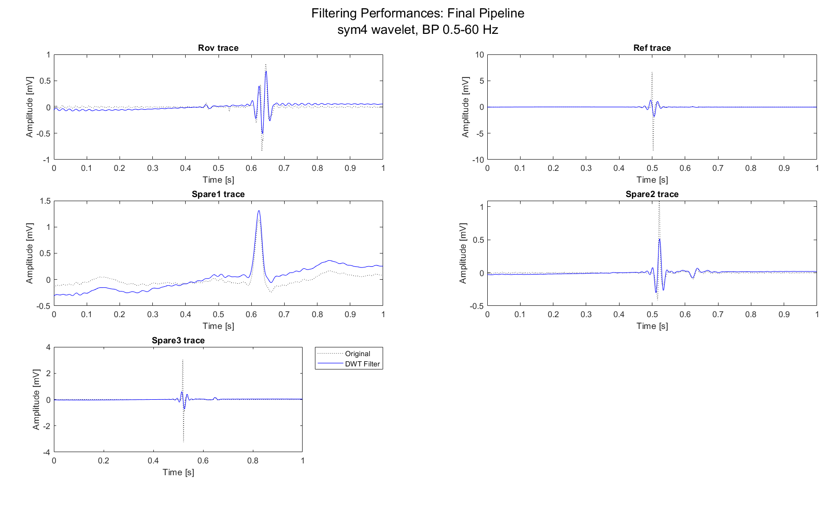
Preprocessing results: AVNRT data
Once build the method into a controlled environment, it can be tested on AVNRT data:
MAP C, sub-1, record example
MAP C, sub-7, record example
MAP C, sub-8, record example
As can be seen:
Zero-phase ensures the preservation of peaks location
Important peaks (A-H-V) preserved
Clearly visible peaks lowering
Presence of boundary effects
Mitigated if the lower cutoff frequency is higher, like 3 Hz

Slide 10
Conclusions on preprocessing
A robust preprocessing pipeline it has been evaluated on ECG signals:
Simulated environment leads to good results, open the door for a real-life scenario
Didactical examples enhancing the usage of DWT + BP strategy, choice even supported by literature
AVNRT data require little adaptations of the pipeline. In this case, high frequency components of some signal present in the database are very muted.
In conclusion, DWT + BP pipeline is a strong and reliable tool that can be used in the following steps. Two aspects should also be considered when choosing whether to apply preprocessing:
Presence of previously made preprocessing
Nature and typology of features

Slide 11
Outline
Recap of objectives so far
Signal preprocessing
Spectrum estimation
Signals alignment
Possible features of Rov Signals
Conclusions

Slide 12
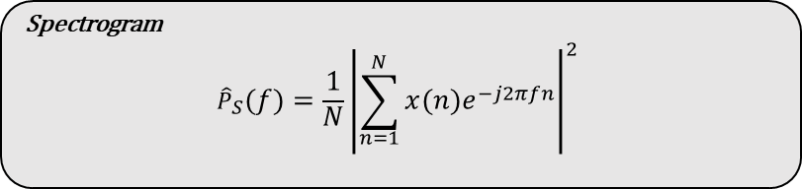
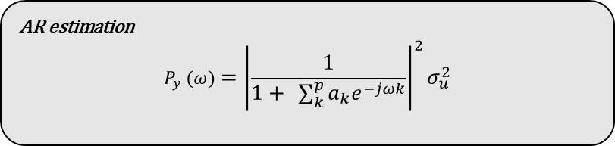
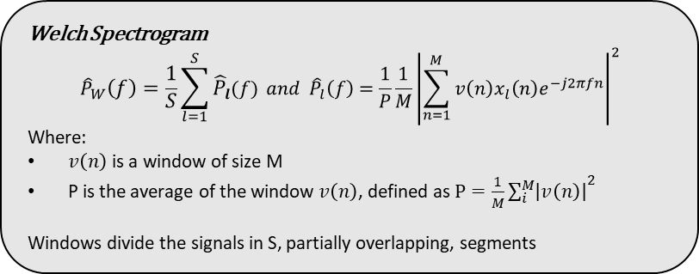
Spectrum estimation
Spectrum estimation can be done following different strategies:
Parametric strategies: i.e., AR estimation
Require zero mean, stationary signals
Consistent and not windowed spectrum estimation
Easy and fast application
Order choice and parameters estimator are crucial
Non-Parametric Strategies: i.e., Spectrogram or Welch estimation
Tend to be noisy
Could require windowing
Easy and fast application
Literature suggest the usage of Non-parametric strategies on ECG signals, but it’s clearly a trade off:
On one hand, AR estimation cannot be used because of non-verification of the signal hypothesis: ECG signals are not stationary.
On the other hand, Non-parametric strategies are noisy and hard to interpretate.
AR estimation
$$P_{y} (ω)={\left|\frac{1}{1+ \sum_{k}^{p}{a_{k}e^{−jωk}}}\right|}^{2}σ_{u}^{2}$$
Spectrogram
$${\hat{P}}_{S}\left(f\right)=\frac{1}{N}{\left|\sum_{n=1}^{N}{x\left(n\right)e^{−j2πfn}}\right|}^{2}$$
Welch Spectrogram
$${\hat{P}}_{W}\left(f\right)=\frac{1}{S}\sum_{l=1}^{S}{{\hat{P}}_{l}(f)} and {\hat{P}}_{l}\left(f\right)=\frac{1}{P}\frac{1}{M}{\left|\sum_{n=1}^{M}{v\left(n\right)x_{l}\left(n\right)e^{−j2πfn}}\right|}^{2}$$
Where:
$v\left(n\right)$ is a window of size M
P is the average of the window $v\left(n\right)$, defined as $P=\frac{1}{M}{\sum_{i}^{M}{\left|v\left(n\right)\right|}}^{2}$
Windows divide the signals in S, partially overlapping, segments

Slide 13
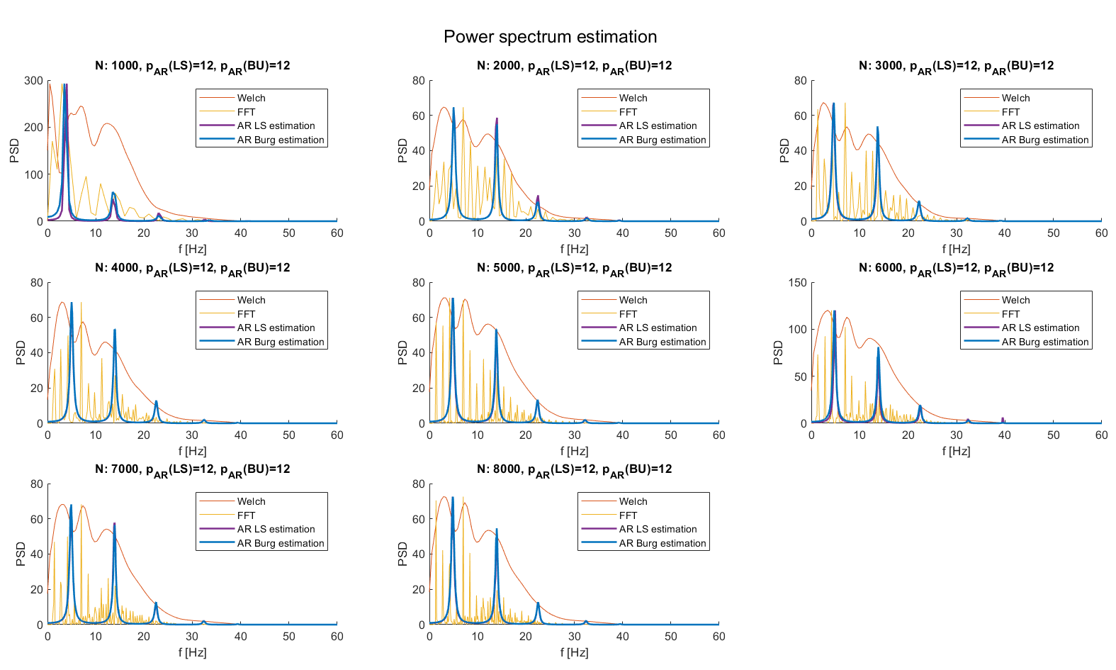
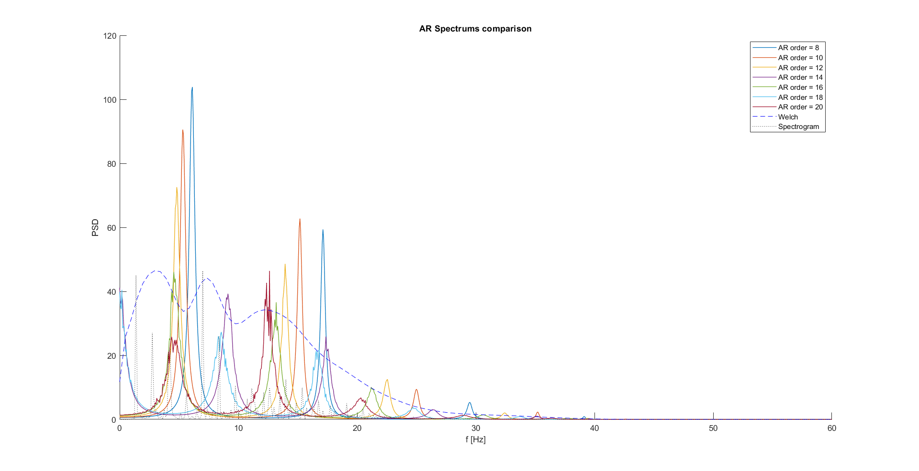
Spectrum estimation results: External data
The proposed spectrum estimation pipeline has been tested on well-know external data (didactical) and compared with the more used Spectrogram and Welch spectrogram.
Each subplot correspond to a spectrum evaluation of a HF noise corrupted signal with an increased number of points (i.e., beats) filtered with the proposed pipeline.
Burg and LS estimators converge, but AR spectrums, Welch spectrums and spectrograms does not lead to comparable results.
AR estimation seems to underestimate the signal, thus AR spectrum peaks are not aligned with the Welch ones.
Moreover, by changing the order, AR spectrum peaks moves, leading to the conclusion that AR spectral estimation does not provide satisfactory results.
Spectrum estimation is still an open problem to be investigated in the future.
LS estimation

Slide 14
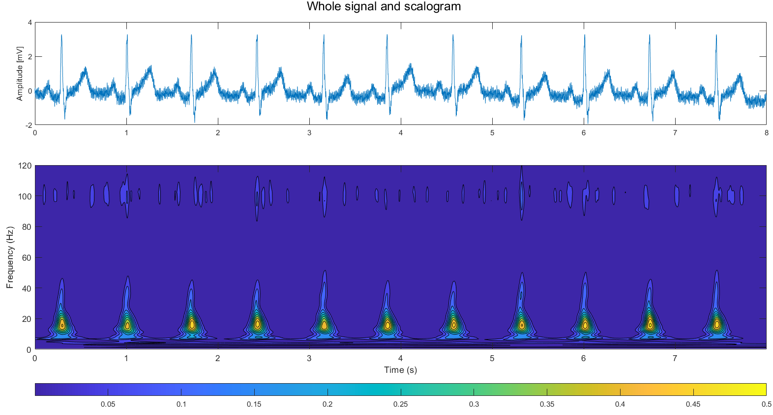
Spectrum estimation: comments
Now a dilemma arises:
On one hand, is known that spectral estimation could leave important insights on the data characteristics
On the other hand, traditional methods have inner limitations that discourage (or even preclude) their usage.
So, are there other methods that can be used?
As done in other studies [3], from FFT spectrums could be extracted some distributional features (e.g., Spectrum density in certain sub-bands)
There are spectrum estimation techniques build to treat correctly semi-periodic signals as ECG, i.e., eigen-based methods [4]
Many studies use DWT features as descriptors of the frequency behavior of ECG signals [5,6]
Other uses even 2-D representations of DWT, i.e., scalograms [7]
3. G. Baldazzi, M. Orrù, G. Viola, e D. Pani, «Computer-aided detection of arrhythmogenic sites in post-ischemic ventricular tachycardia», Sci Rep, vol. 13, fasc. 1, p. 6906, apr. 2023
4. S. V. Vaseghi, Advanced digital signal processing and noise reduction, 2nd ed. Chichester: Wiley, 2001.
5. P. deChazal, M. O’Dwyer, e R. B. Reilly, «Automatic Classification of Heartbeats Using ECG Morphology and Heartbeat Interval Features», IEEE Trans. Biomed. Eng, lug. 2004
6. S. Faziludeen e P. V. Sabiq, «ECG beat classification using wavelets and SVM», in 2013 IEEE CONFERENCE ON INFORMATION AND COMMUNICATION TECHNOLOGIES, apr. 2013, pp. 815–818
7. Y. D. Daydulo, B. L. Thamineni, e A. A. Dawud, «Cardiac arrhythmia detection using deep learning approach and time frequency representation of ECG signals», BMC Med Inform Decis Mak, vol. 23, fasc. 1, p. 232, ott. 2023

Slide 15
Outline
Recap of objectives so far
Signal preprocessing
Spectrum estimation
Signals alignment
Possible features of Rov Signals
Conclusions

Slide 16
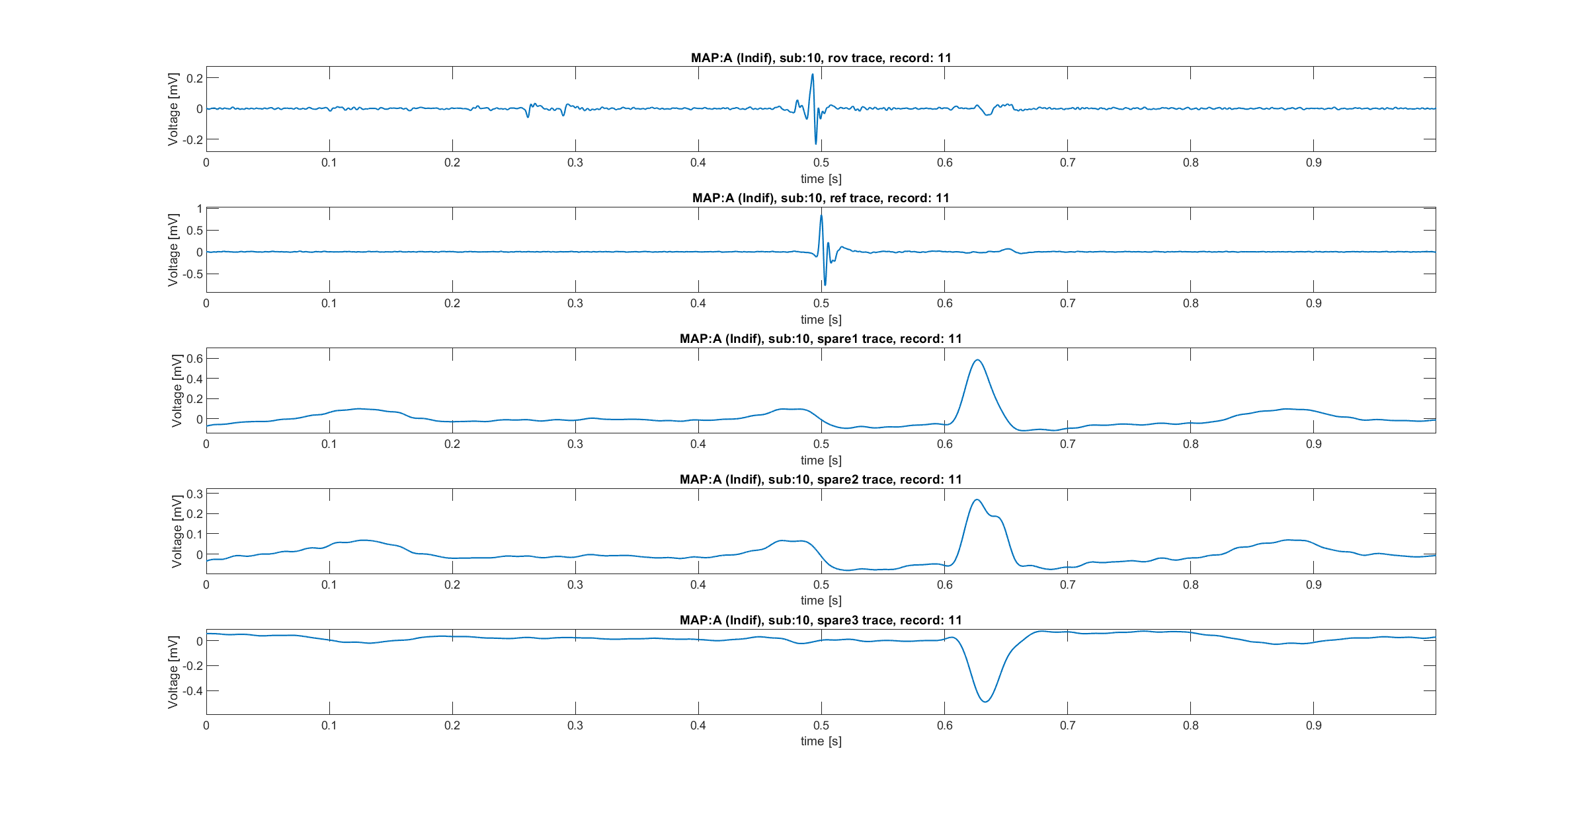
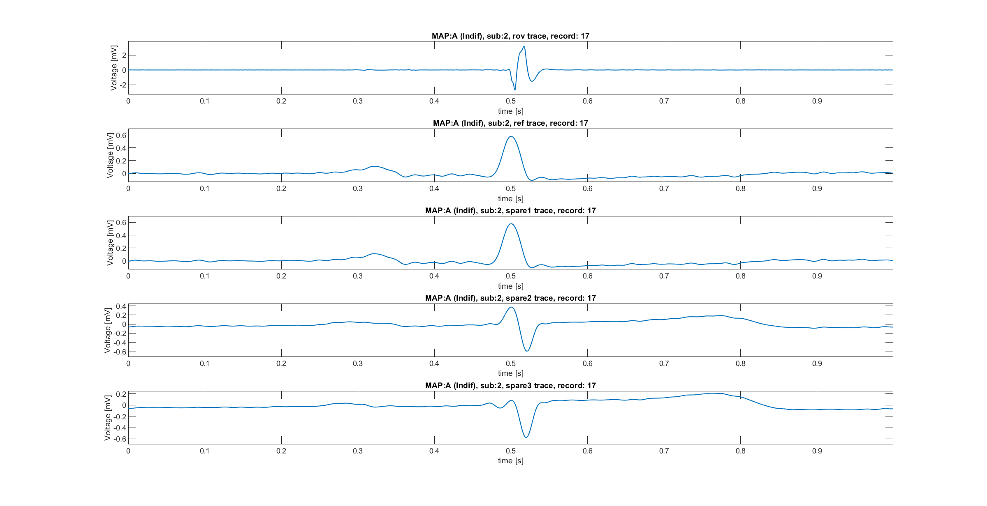
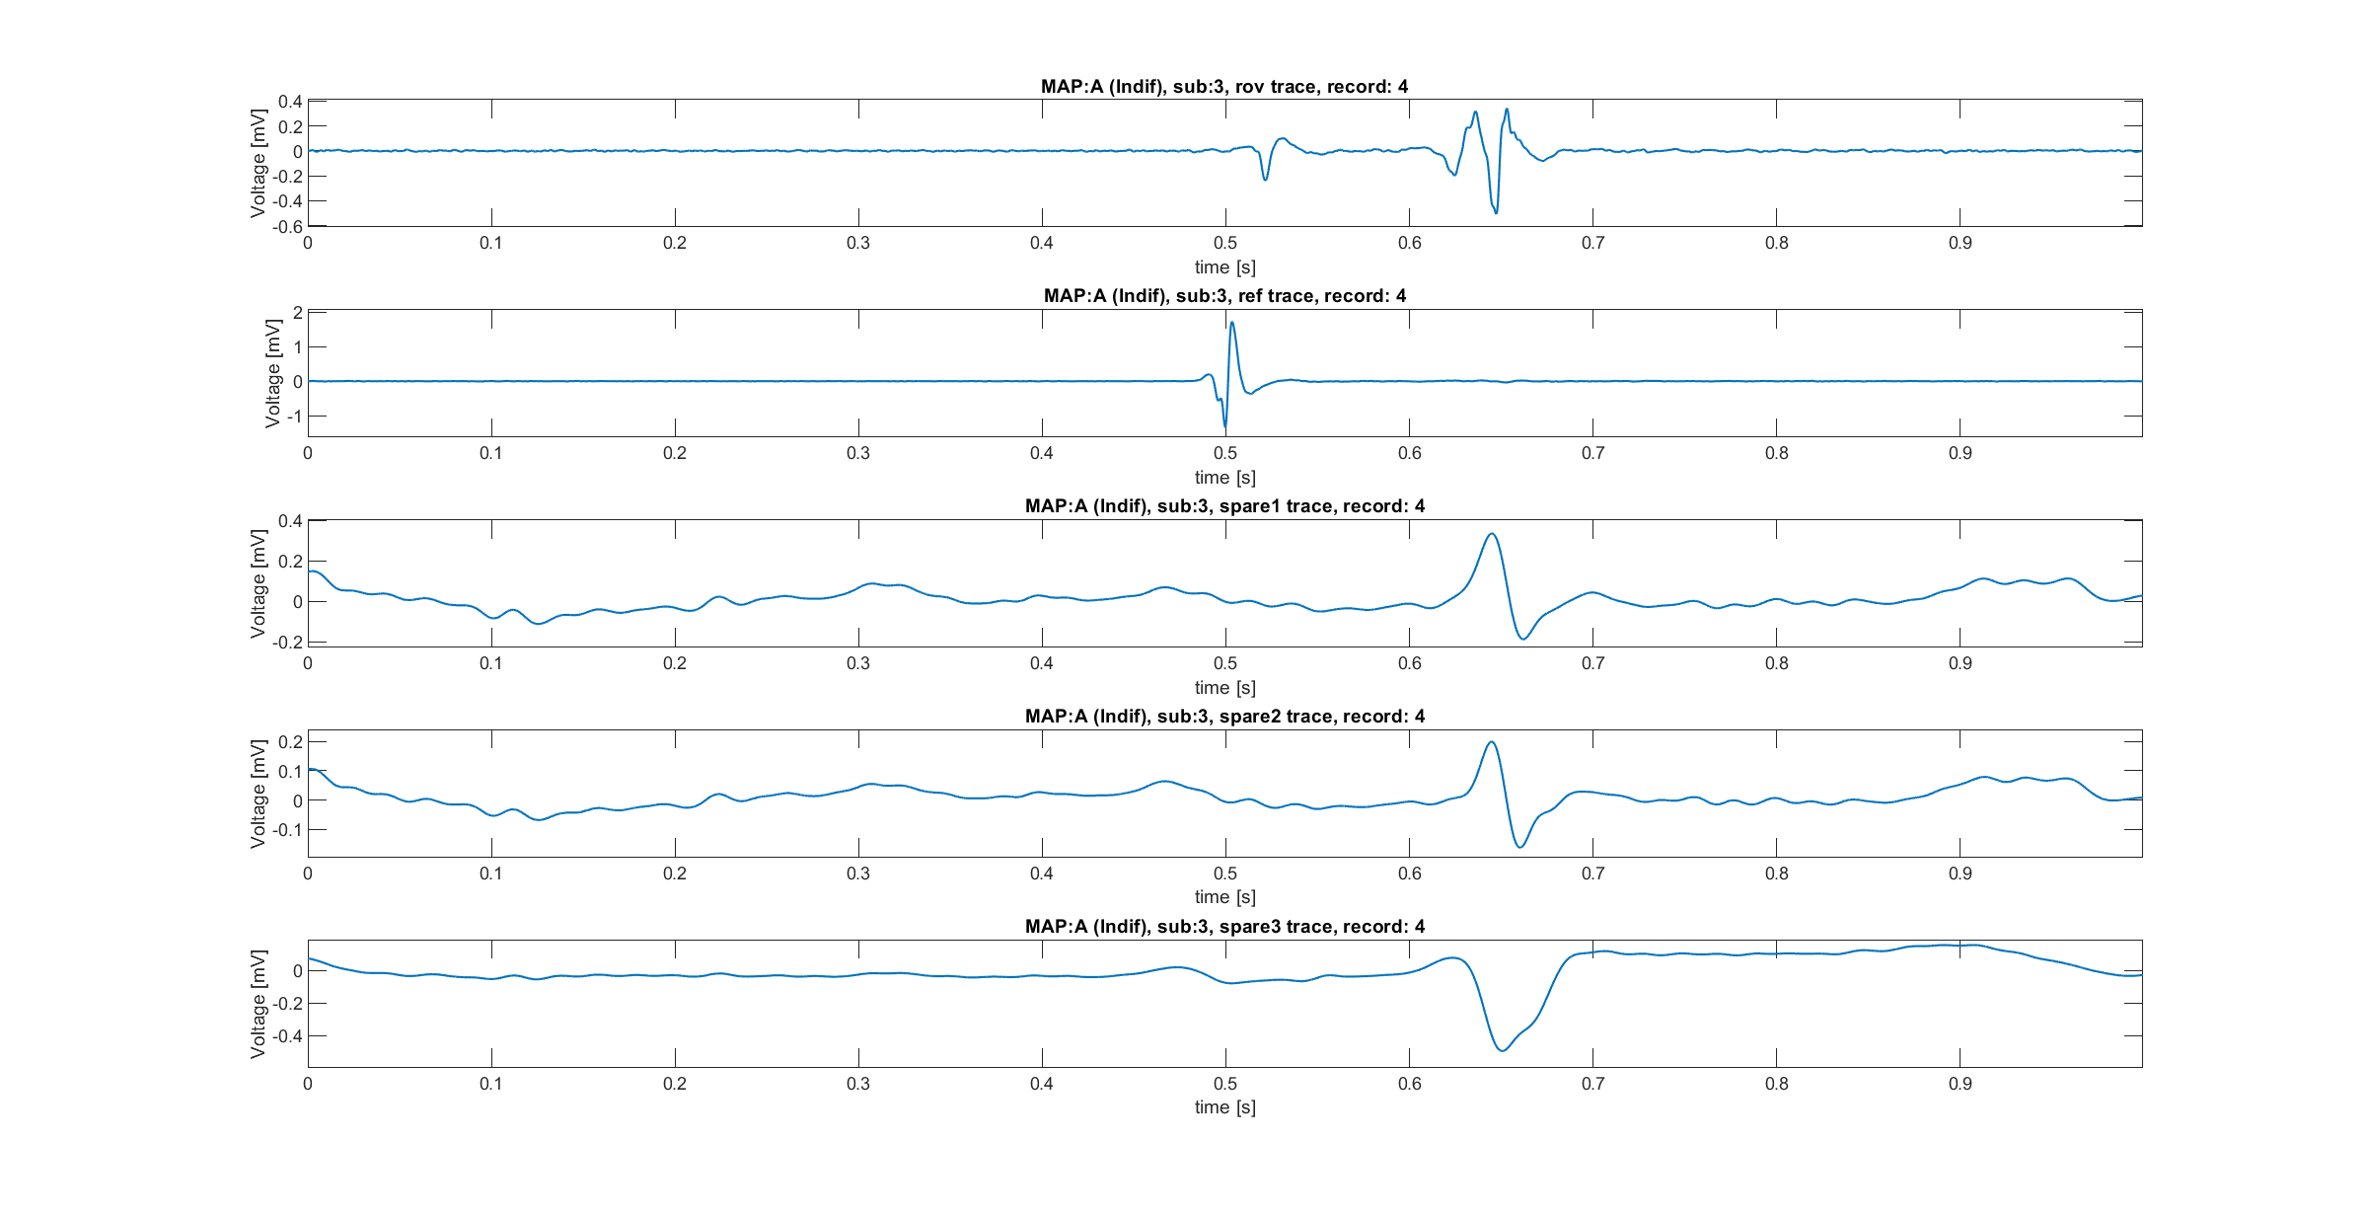
Alignment necessity
Alignment was found to be necessary to build a population dataset. In fact:
Localize correctly atrial, ventricular and His conduction is fundamental
Between subjects, there are differences into the peak’s alignment
The key idea is aligning the Rov trace respect to a QRS. Presumably, the Ref trace should play the role of trace against which align.
But:
Reference traces does not seem to contain always a QRS
Reference traces, as said in previous meetings, should be the same as spare 1 traces, but this is not true (or at least it is just for subjects 2 and 4)
Atrial
Ventricular

Slide 17
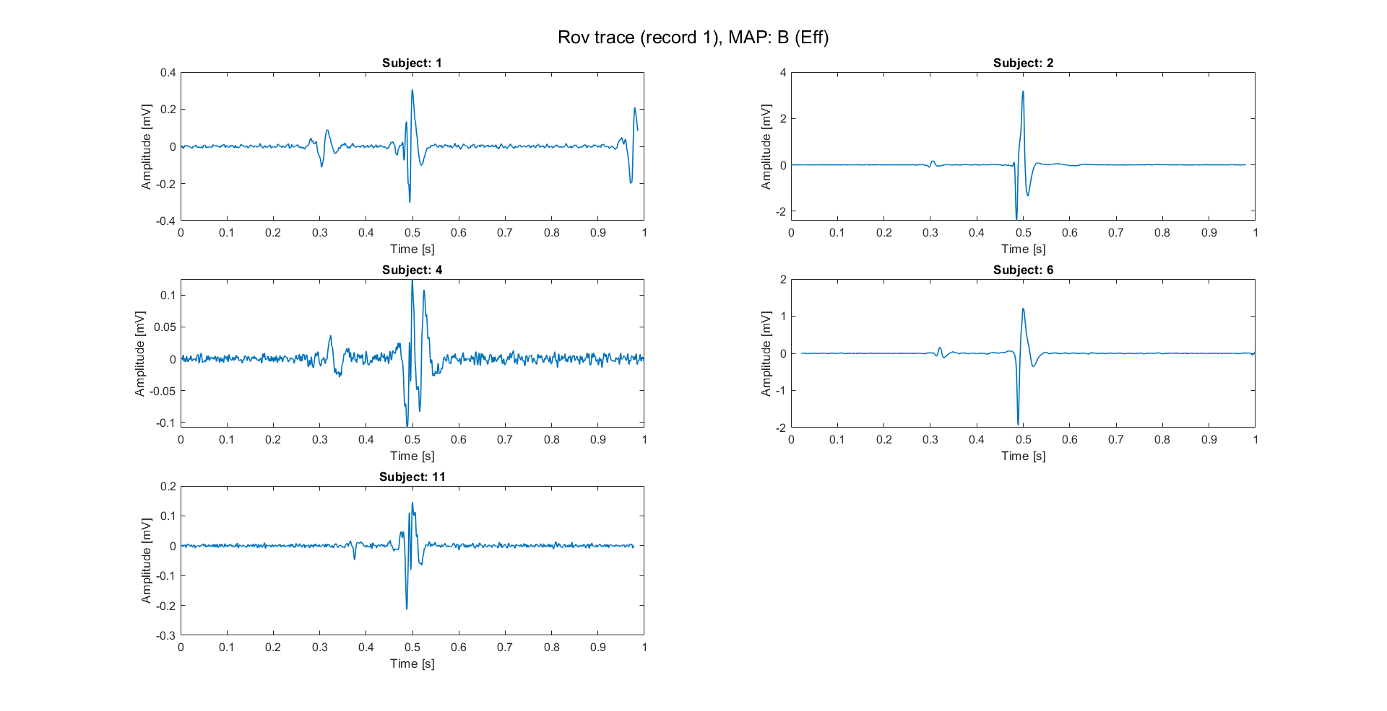
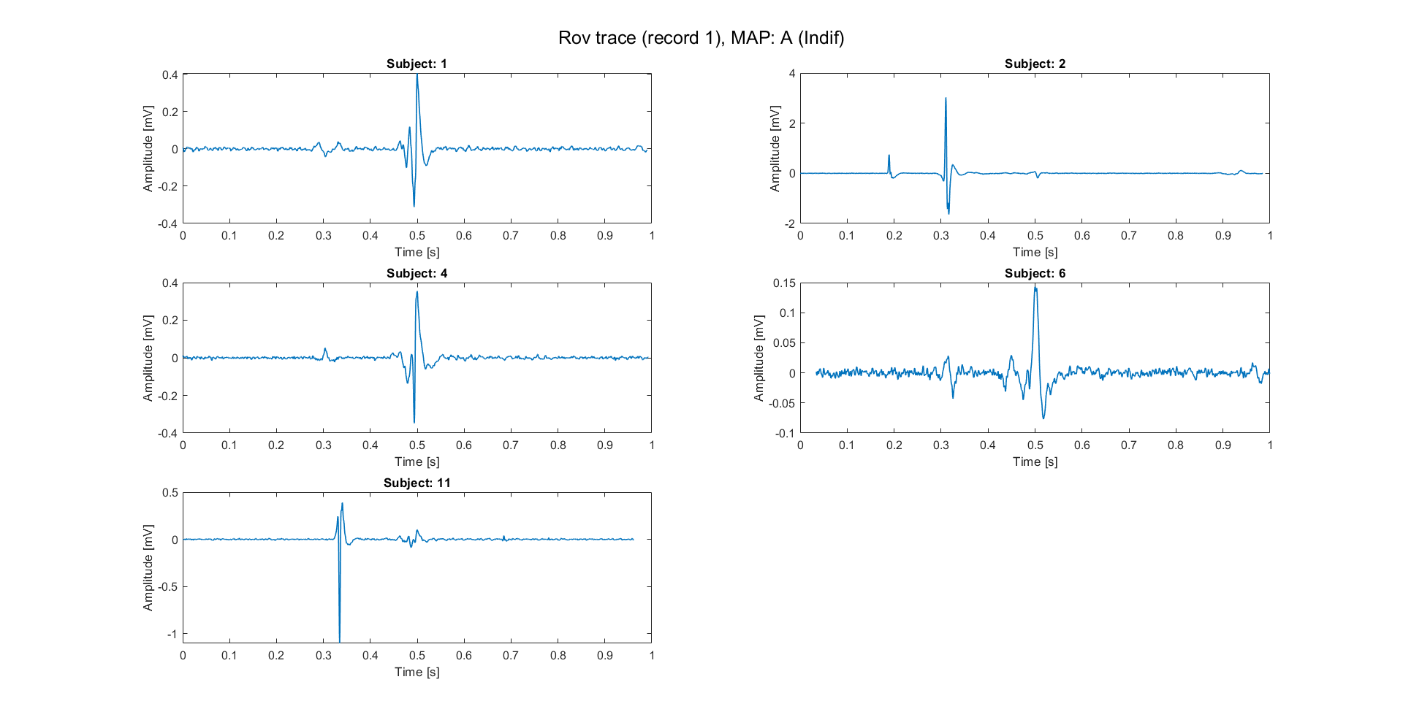
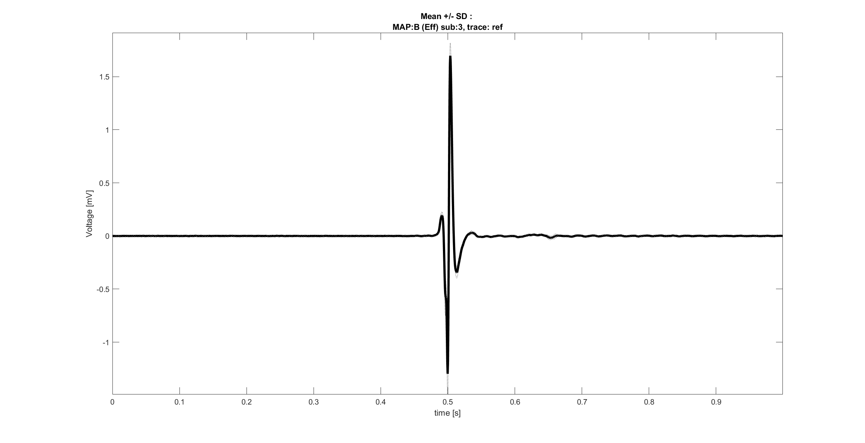
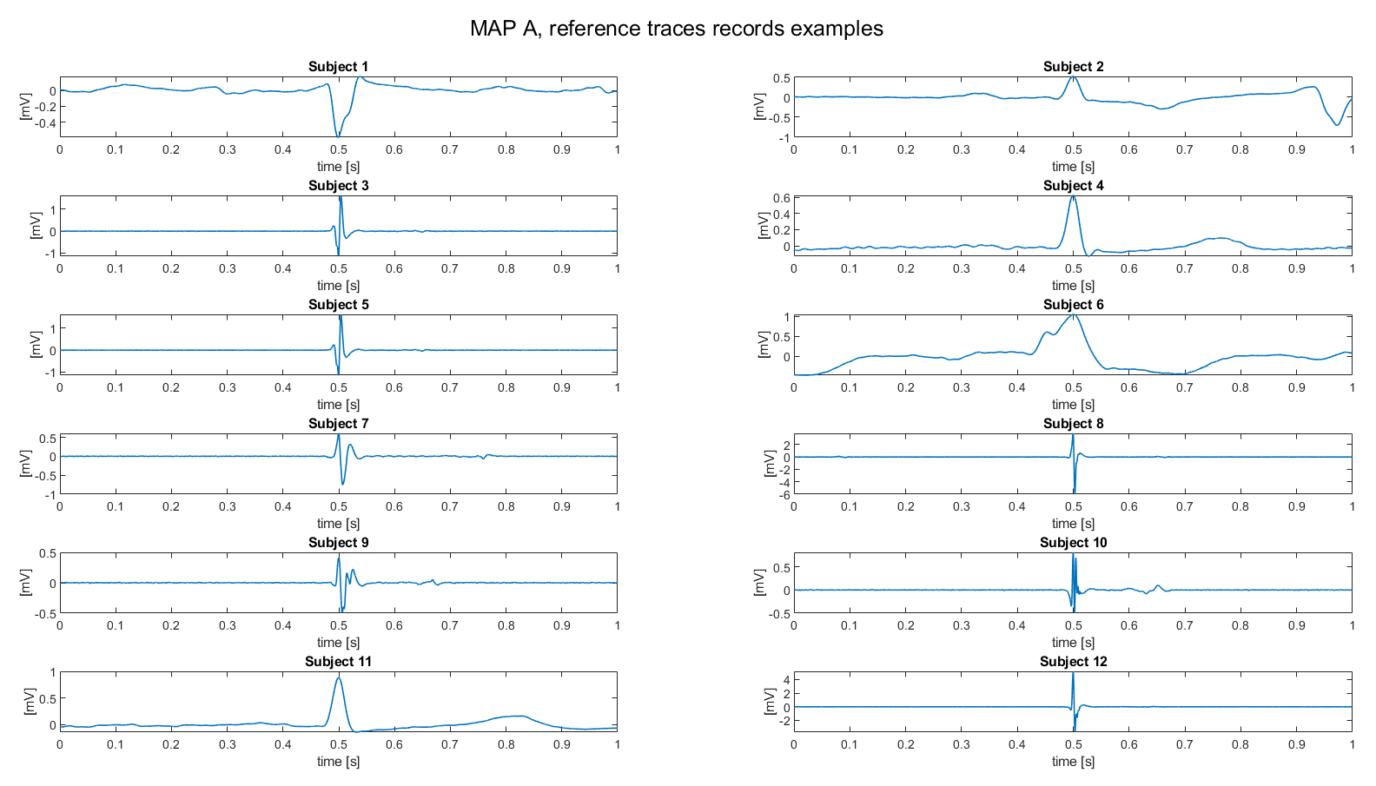
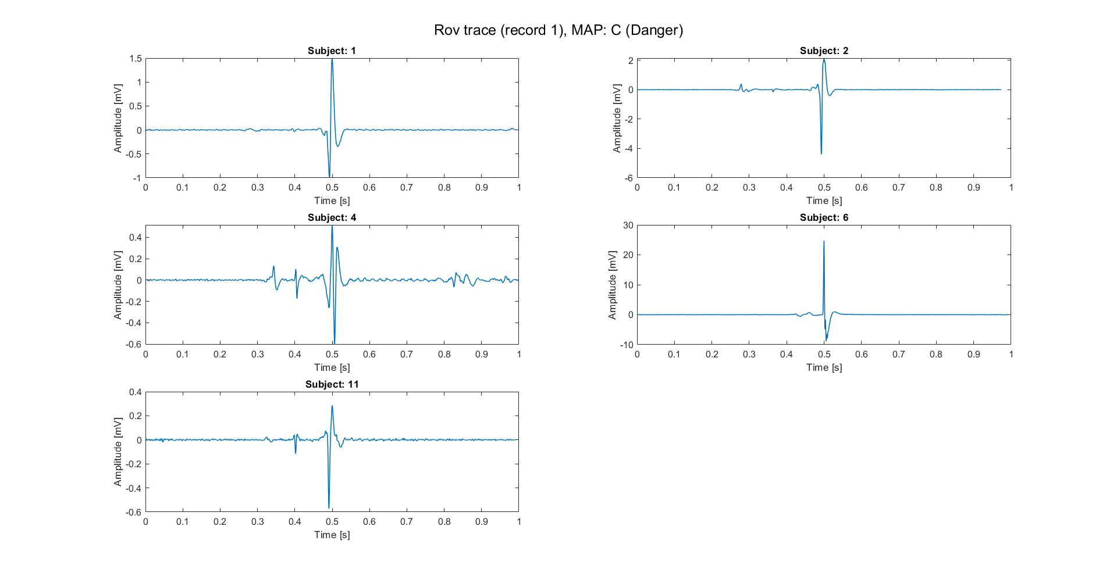
Alignment: open questions
It’s now necessary answer to some crucial questions:
Is it possible that reference traces are traces without the QRS?
Are the reference traces preprocessed by align them respect to 0.5 seconds?
Which is the nature of Spare traces?
Once answered to these questions, it could be possible building a population dataset, where all traces have a certain component (e.g., the ventricular conduction) aligned respect to a common point (e.g., 0.5 seconds).
Here, examples of aligned traces are reported. These traces are related to subjects in whom the ref trace presented a clear QRS (sub: 1,2,4,6,11).

Slide 18
Outline
Recap of objectives so far
Signal preprocessing
Spectrum estimation
Signals alignment
Possible features of Rov Signals
Conclusions

Slide 19
Next step: feature extraction
Rov signals
Morphological features (time domain)
Points of the signal, even sub-sampled [9]
Fragmentation (number of peaks of the signal) [10]
PCA/ICA representations of the signal [9]
Filter and normalize
Alignment respect to a common point
Morphological features (Frequency domain)
Mean, variance, energy of DWT coefficients on different levels of decomposition [9]
Relative power of PSD on fixed sub-bands [10]
PCA/ICA representations of frequency domain features [9]
Feature extraction on Rov records
Label
Map A, Map B, Map C
9. E. J. D. S. Luz, W. R. Schwartz, G. Cámara-Chávez, e D. Menotti, «ECG-based heartbeat classification for arrhythmia detection: A survey», Computer Methods and Programs in Biomedicine, vol. 127, pp. 144–164, apr. 2016.
10. G. Baldazzi, M. Orrù, G. Viola, e D. Pani, «Computer-aided detection of arrhythmogenic sites in post-ischemic ventricular tachycardia», Sci Rep, vol. 13, fasc. 1, p. 6906, apr. 2023

Slide 20
Outline
Recap of objectives so far
Signal preprocessing
Spectrum estimation
Signals alignment
Possible features of Rov Signals
Conclusions

Slide 21
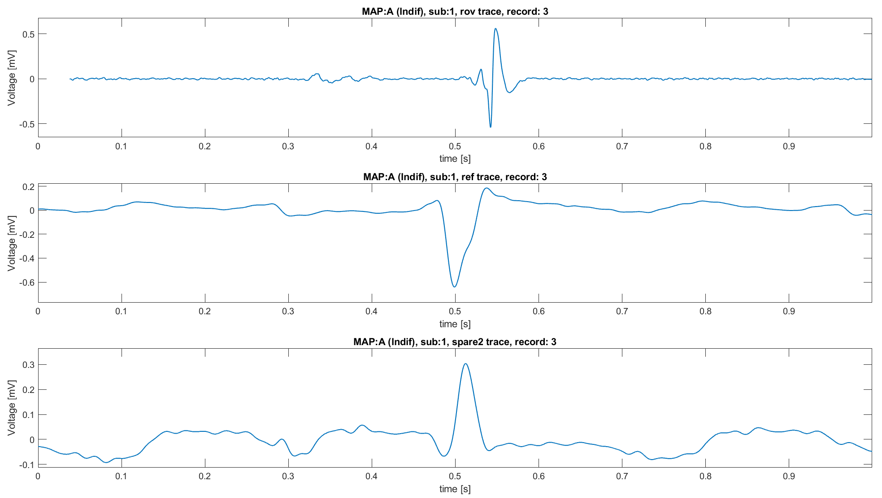
Conclusions
So far, some progress has been made on understanding the signals :
A reliable preprocessing pipeline it has been build and it’s ready in case of future necessity.
Spectrum evaluation criticalities have been studied and alternatives were proposed.
A data alignment strategy has been proposed but before proceeding some questions should be answered.
Once clarified these aspects, there’s another open question: why are there signals afferent to MAP A with clearly characteristics of MAP B?
Noise and bad positioning of the electrode
Necessity of positional information to completely characterize the signal (i.e., the heart surgeon knows where he’s located with the electrode and uses this information to “classify” the signal)
Since the classification is done a posteriori (knowing the ablation result), it is possible that the signal may be afferent to a certain MAP even though its characteristics do not suggest the classification assigned to it
Why?

Slide 22
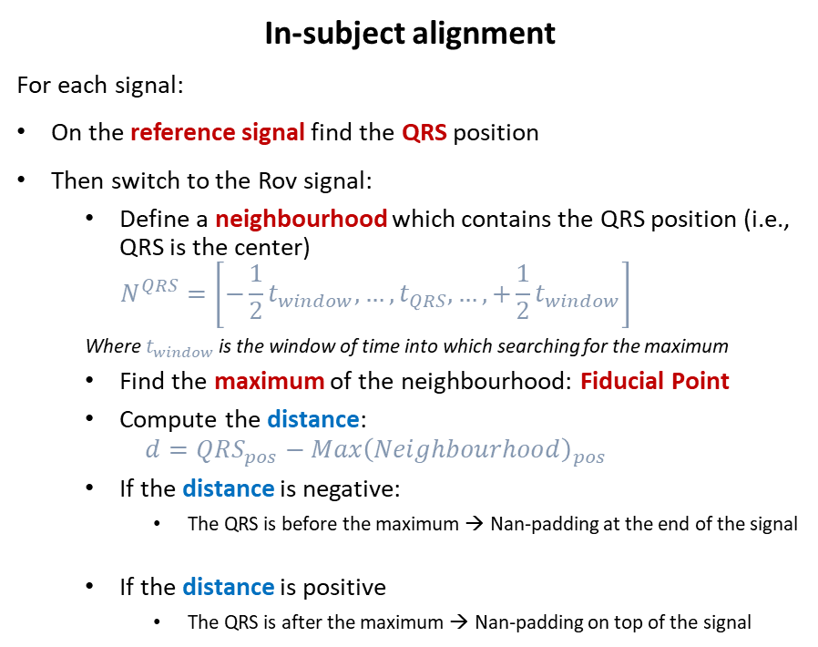
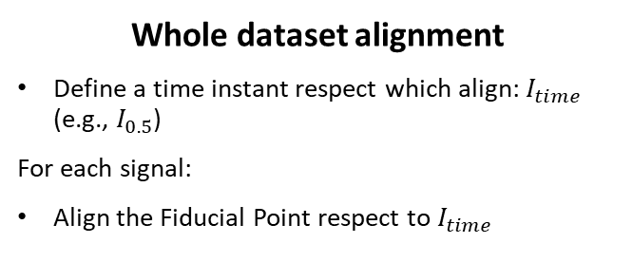
Traces alignment pipeline
In-subject alignment
For each signal:
On the reference signal find the QRS position
Then switch to the Rov signal:
Define a neighbourhood which contains the QRS position (i.e., QRS is the center)
$$N^{QRS}=\left[−\frac{1}{2}t_{window},…,t_{QRS},…,+\frac{1}{2}t_{window}\right]$$
Where $t_{window}$ is the window of time into which searching for the maximum
Find the maximum of the neighbourhood: Fiducial Point
Compute the distance:
$$d=QRS_{pos}−Max{\left(Neighbourhood\right)}_{pos}$$
If the distance is negative:
The QRS is before the maximum → Nan-padding at the end of the signal
If the distance is positive
The QRS is after the maximum → Nan-padding on top of the signal
Whole dataset alignment
Define a time instant respect which align: $I_{time}$ (e.g., $I_{0.5}$)
For each signal:
Align the Fiducial Point respect to $I_{time}$
Hyperparameter: Time window: 0.1 s

